Slide 1







IEEE SSH 2024
HACKATHON
KATHON

Slide 2



Team name:
Coding Enthusiasts
Team Members name:
Nayni Singhal (Team Lead) [3RD Year] CSE(AI&ML)
Shipra Maurya [3RD Year] CSE(AI&ML)
Vedanshi Kaushik [3RD Year] CSE(AI&ML)

Slide 3



Problem statement
The world generated 62 million tonnes of e-waste in 2022, and this figure is projected to rise to 82 million tonnes by 2030.
Global E-Waste Monitor 2024
Only about 22.3% of this 62 million tonnes waste is properly recycled, wasting around $62 billion worth of valuable resources annually.
E-waste is rapidly growing, with over 50 million tons generated annually.
Current disposal methods are ineffective and lack user engagement.
The need arises for an interactive platform featuring uploading of e-waste images, real-time e-waste tracking, educational resources, and interactive elements to encourage recycling, locate collection centers, and promote sustainable e-waste practices.

Slide 4
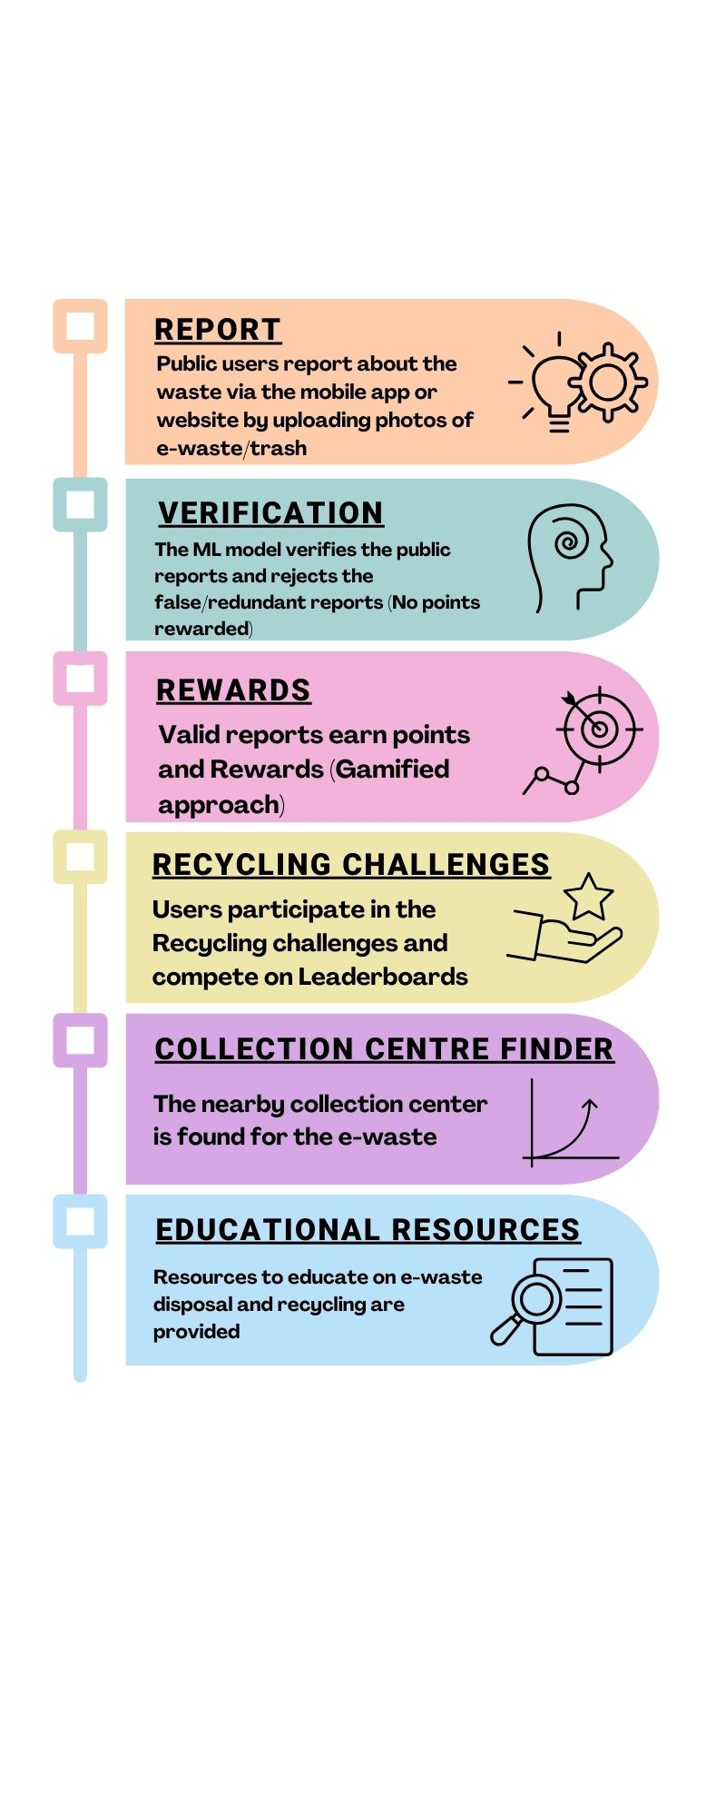
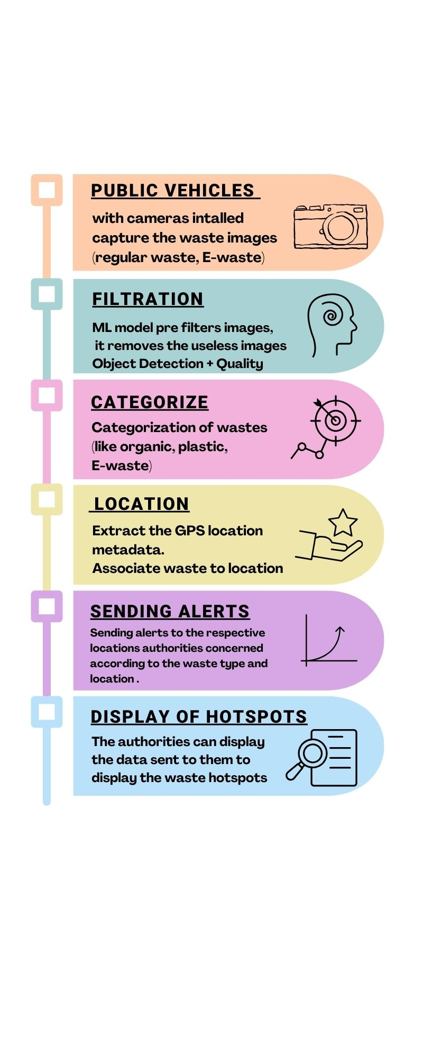
Solution
WORKING OF PLATFORM:
USER INTERACTION:
Interactive E-Waste Management
Developing a user-friendly and interactive platform that transforms e-waste management into an engaging experience.
The solution features a platform to upload images of e-waste, real-time tracking of e-waste, educational resources on responsible disposal, and gamified elements to motivate recycling.
Incorporation of tools for finding collection centers, earning rewards, and participating in recycling challenges to enhance user engagement and promote sustainable e-waste

Slide 5


USP
Real-Time
E-Waste Tracking
Interactive Recycling
Reward System
Upload E-waste images
Collection Center Finder
Educational Resources

Slide 6


Tech Stack
Frontend:
React : Provides dynamic, interactive interfaces for both web and mobile users, ensuring consistency across platforms.
Tailwind CSS & Google Maps API: Offers responsive styling and GPS-based visualization of waste hotspots and collection centers.
Backend:
Node.js with Express: Manages API requests and data flow efficiently between frontend and backend.
Socket.io: Facilitates real-time notifications and updates, enhancing user engagement and interaction.
Data Storage and Management:
MongoDB: Provides flexible storage for both structured and unstructured data.
Google Cloud Storage: Stores uploaded images and other media files securely and efficiently.
Location Services:
Google Maps API: Enables accurate GPS tracking and visualization of waste hotspots and e-waste collection centers.
Machine Learning:
YOLOv5 : utilized for real time object detection.
PyTorch : Builds the object detection model and handles image pre-processing for accurate waste identification.
Interactive Education:
Unity : Educational modules consisting of text, videos and 3d display through AR make the experience of learning interactive
GameSparks: Manages leaderboards, points, and challenges to maintain user engagement.

Slide 7


Future aspect
AI-Powered Recycling Suggestions
Personalized tips via AI, boosting engagement and user retention.
Sustainability Education Hub with Sponsored Content
Rewards users with redeemable points, fostering brand loyalty and partnerships
Blockchain for Secure Recycling Data
Ensures transparent, traceable e-waste processes, building user trust and partnerships.
Gamified Recycling Rewards Program
Offer sponsored educational content, generating revenue and promoting sustainability awareness.
Corporate Partnerships & Bulk Recycling Programs
Partner with businesses for bulk recycling, generating new B2B revenue streams.

Slide 8
Thank You

